Slide 1

RMSC5102 Final Review
Leung Man Fung, Heman
Spring, 2021

Slide 2
Agenda
Review
Basic Knowledge
The Black-Scholes World
Monte Carlo Method
Random Variable Generation
Variance Reduction Technique
Simulation in Action
Q&A

Slide 3
Basic Knowledge

Slide 4
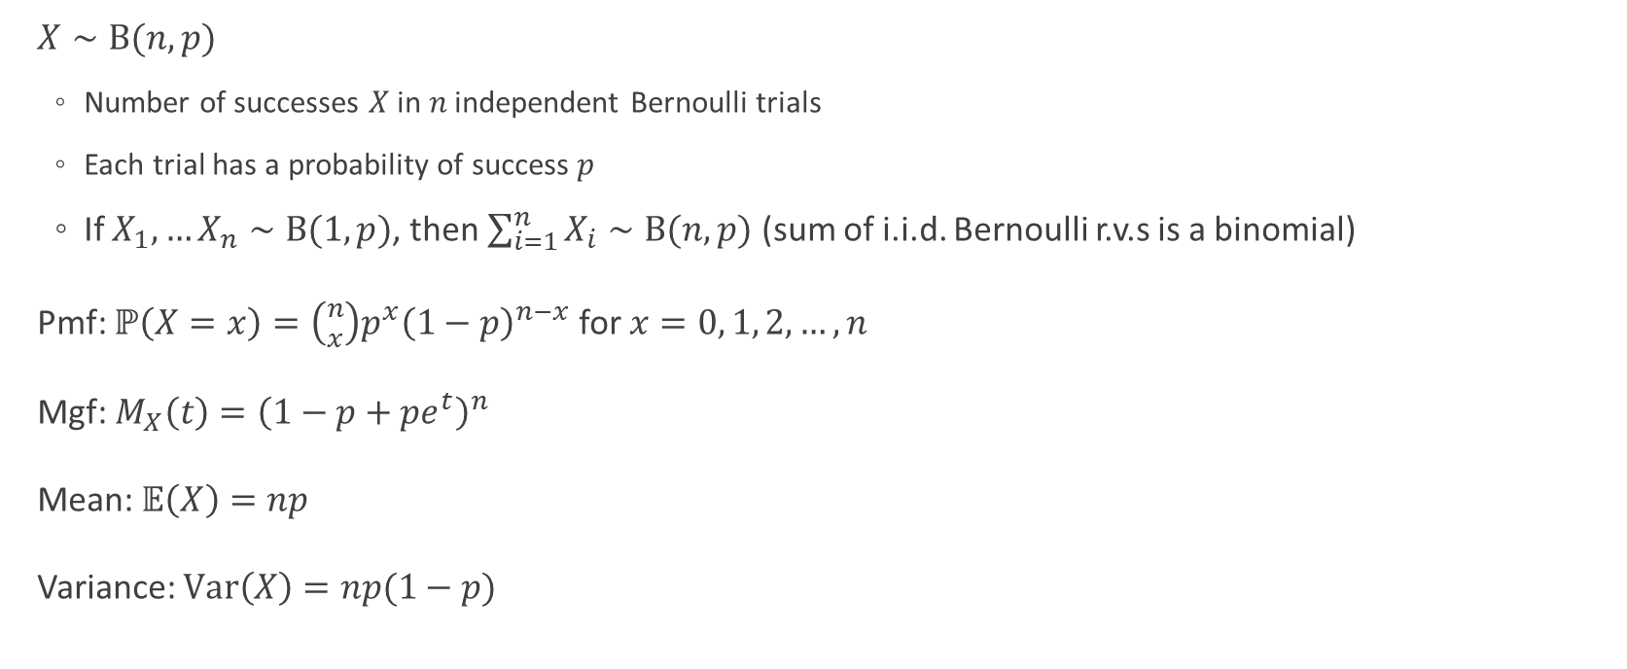
Binomial Distribution
$X∼\text{B}(n,p)$
Number of successes 𝑋 in 𝑛 independent Bernoulli trials
Each trial has a probability of success 𝑝
If $X_{1},…X_{n}∼B(1,p)$, then $\sum_{i=1}^{n}{X_{i}}∼B(n,p)$ (sum of i.i.d. Bernoulli r.v.s is a binomial)
Pmf: $ℙ\left(X=x\right)=\left({n \atop x}\right)p^{x}{\left(1−p\right)}^{n−x}$ for $x=0, 1, 2, …, n$
Mgf: $M_{X}\left(t\right)={\left(1−p+pe^{t}\right)}^{n}$
Mean: $𝔼\left(X\right)=np$
Variance: $\text{Var}\left(X\right)=np(1−p)$

Slide 5
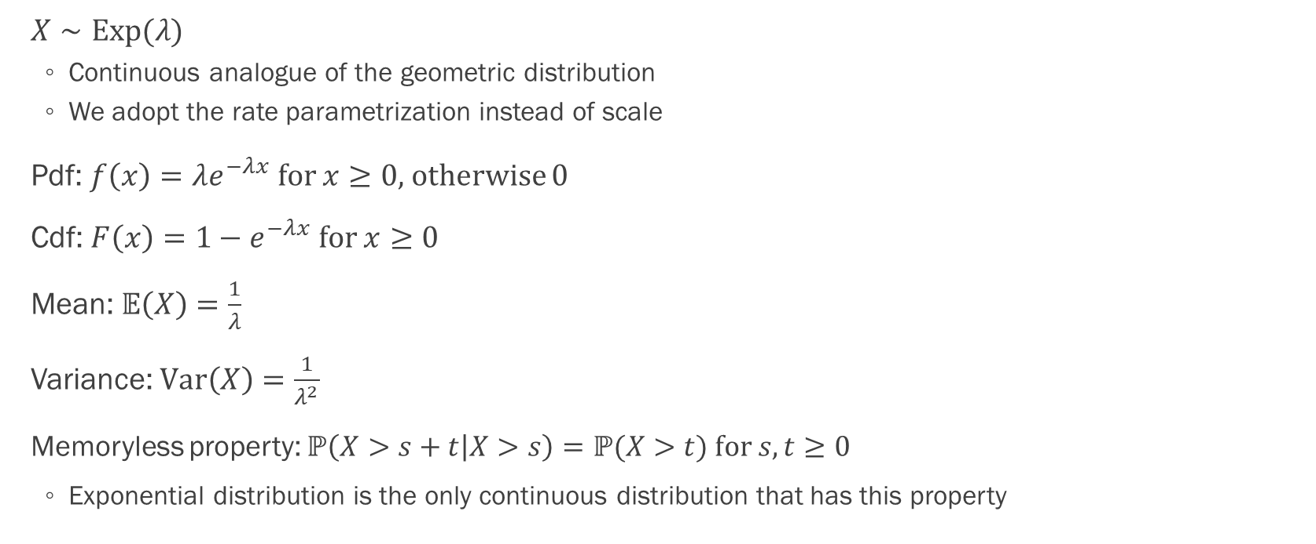
Exponential Distribution
$X∼Exp(λ)$
Continuous analogue of the geometric distribution
We adopt the rate parametrization instead of scale
Pdf: $f\left(x\right)=λe^{−λx}$ for $x≥0$, otherwise 0
Cdf: $F\left(x\right)=1−e^{−λx}$ for $x≥0$
Mean: $𝔼\left(X\right)=\frac{1}{λ}$
Variance: $\text{Var}\left(X\right)=\frac{1}{λ^{2}}$
Memoryless property: $ℙ\left(X>s+t | X>s\right)=ℙ(X>t)$ for $s,t≥0$
Exponential distribution is the only continuous distribution that has this property

Slide 6
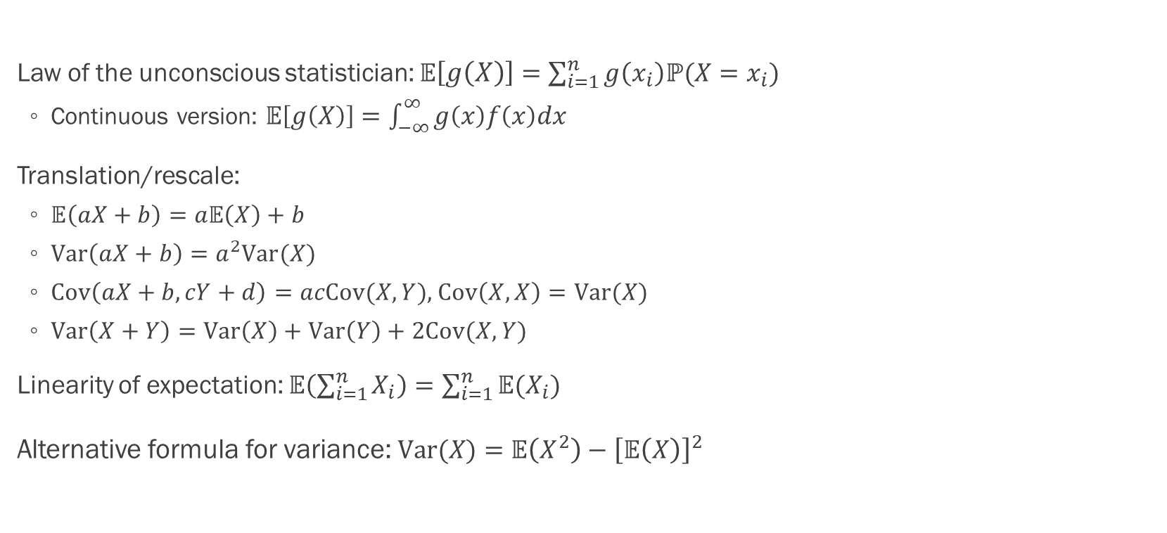
Some Properties of Expectation, Variance and Covariance
Law of the unconscious statistician: $𝔼\left[g\left(X\right)\right]=\sum_{i=1}^{n}{g\left(x_{i}\right)ℙ(X=x_{i})}$
Continuous version: $𝔼\left[g\left(X\right)\right]=\int_{−∞}^{∞}{g\left(x\right)f\left(x\right)dx}$
Translation/rescale:
$𝔼\left(aX+b\right)=a𝔼\left(X\right)+b$
$\text{Var}\left(aX+b\right)=a^{2}\text{Var}(X)$
$Cov\left(aX+b,cY+d\right)=acCov(X,Y)$, $Cov\left(X,X\right)=Var(X)$
$Var\left(X+Y\right)=Var\left(X\right)+Var\left(Y\right)+2Cov(X,Y)$
Linearity of expectation: $𝔼\left(\sum_{i=1}^{n}{X_{i}}\right)=\sum_{i=1}^{n}{𝔼(X_{i})}$
Alternative formula for variance: $\text{Var}(X)=𝔼\left(X^{2}\right)−{\left[𝔼\left(X\right)\right]}^{2}$

Slide 7
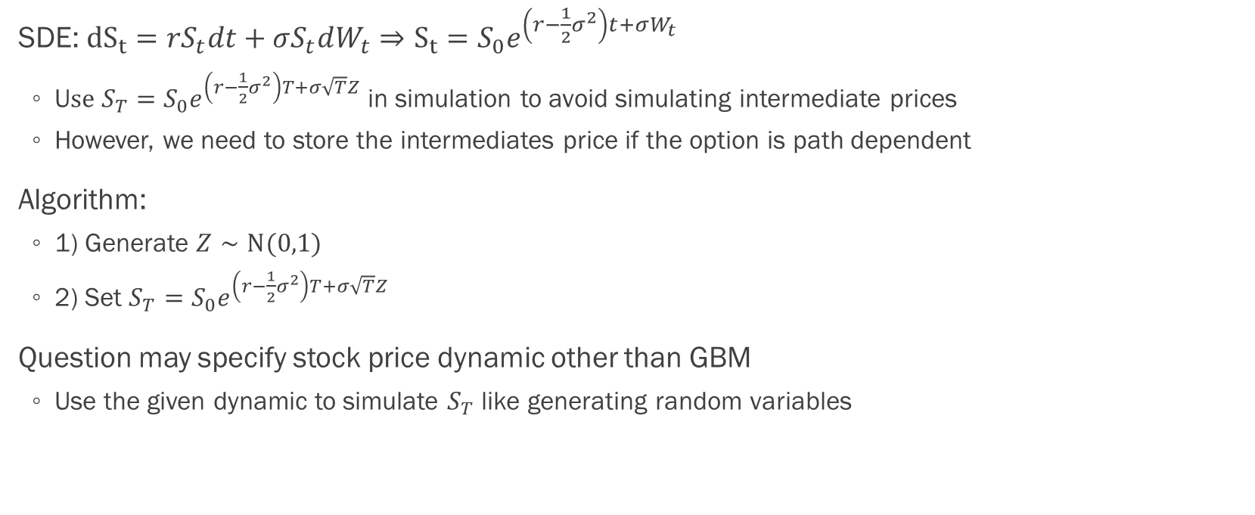
Geometric Brownian Motion
SDE: ${dS}_{t}=rS_{t}dt+σS_{t}dW_{t}⇒S_{t}=S_{0}e^{\left(r−\frac{1}{2}σ^{2}\right)t+σW_{t}}$
U$se S_{T}=S_{0}e^{\left(r−\frac{1}{2}σ^{2}\right)T+σ\sqrt{T}Z}$ in simulation to avoid simulating intermediate prices
However, we need to store the intermediates price if the option is path dependent
Algorithm:
1) Generate $Z∼N(0,1)$
2) Set $S_{T}=S_{0}e^{\left(r−\frac{1}{2}σ^{2}\right)T+σ\sqrt{T}Z}$
Question may specify stock price dynamic other than GBM
Use the given dynamic to simulate $S_{T}$ like generating random variables

Slide 8
The Black-Scholes World

Slide 9
No-arbitrage Pricing
If two portfolios have the same payoff at time T, their costs should agree at time 0
Otherwise, we can earn riskless profit by “buy low sell high”
This assume no limit to arbitrage, e.g., we can short sell without margin
Basic argument in derivative pricing, e.g.,
Put-call parity
Black-Scholes formula

Slide 10
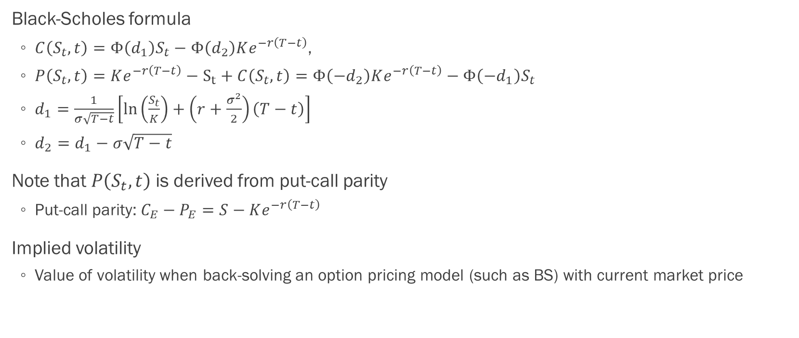
Black–Scholes–Merton Model
Black-Scholes formula
$C\left(S_{t},t\right)=Φ\left(d_{1}\right)S_{t}−Φ\left(d_{2}\right)Ke^{−r\left(T−t\right)}$,
$P\left(S_{t},t\right)=Ke^{−r\left(T−t\right)}−S_{t}+C\left(S_{t},t\right)=Φ\left(−d_{2}\right)Ke^{−r\left(T−t\right)}−Φ\left(−d_{1}\right)S_{t}$
$d_{1}=\frac{1}{σ\sqrt{T−t}}\left[\ln\left(\frac{S_{t}}{K}\right)+\left(r+\frac{σ^{2}}{2}\right)\left(T−t\right)\right]$
$d_{2}=d_{1}−σ\sqrt{T−t}$
Note that $P\left(S_{t},t\right)$ is derived from put-call parity
Put-call parity: $C_{E}−P_{E}=S−Ke^{−r\left(T−t\right)}$
Implied volatility
Value of volatility when back-solving an option pricing model (such as BS) with current market price

Slide 11
Monte Carlo Method

Slide 12
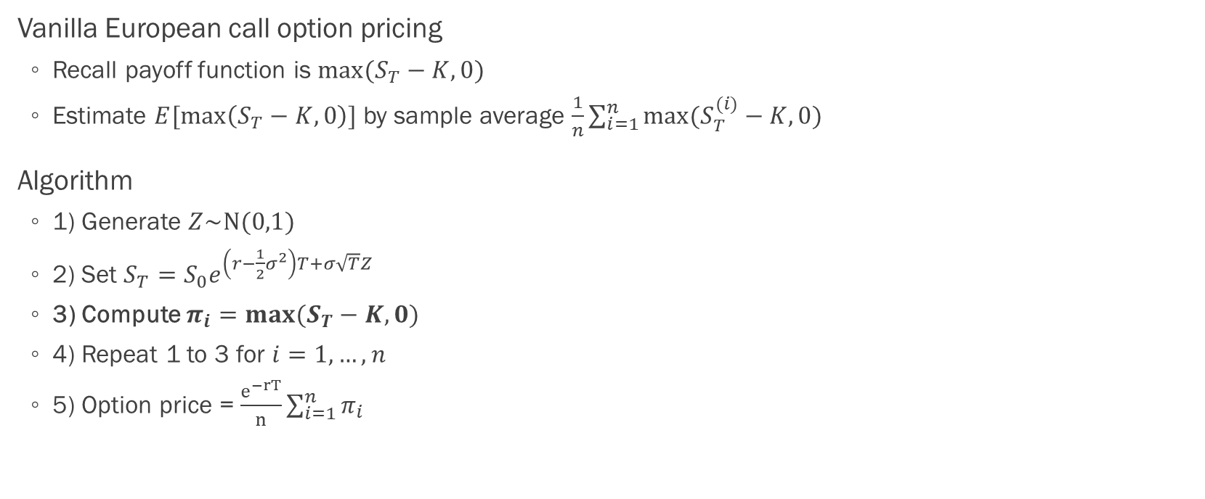
Standard Monte Carlo
Vanilla European call option pricing
Recall payoff function is $max⁡(S_{T}−K,0)$
Estimate $E[\max\left(S_{T}−K,0\right)]$ by sample average $\frac{1}{n}\sum_{i=1}^{n}{max⁡(S_{T}^{(i)}−K,0) }$
Algorithm
1) Generate $Z\sim N(0,1)$
2) Set $S_{T}=S_{0}e^{\left(r−\frac{1}{2}σ^{2}\right)T+σ\sqrt{T}Z}$
3) Compute $π_{i}=max⁡(S_{T}−K,0)$
4) Repeat 1 to 3 for $i=1,…,n$
5) Option price = $\frac{e^{−rT}}{n}\sum_{i=1}^{n}{π_{i}}$

Slide 13
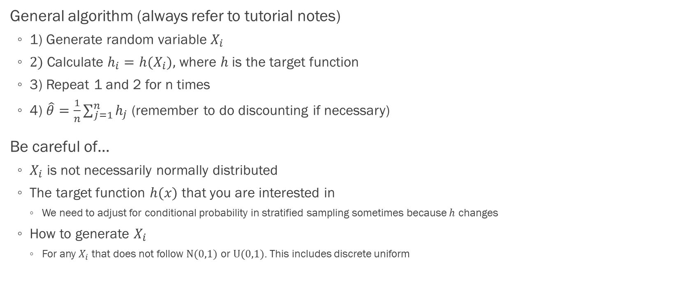
Things to Note
General algorithm (always refer to tutorial notes)
1) Generate random variable $X_{i}$
2) Calculate $h_{i}=h(X_{i})$, where $h$ is the target function
3) Repeat 1 and 2 for n times
4) $\hat{θ}=\frac{1}{n}\sum_{j=1}^{n}{h_{j}}$ (remember to do discounting if necessary)
Be careful of…
$X_{i}$ is not necessarily normally distributed
The target function $h(x)$ that you are interested in
We need to adjust for conditional probability in stratified sampling sometimes because $h$ changes
How to generate $X_{i}$
For any $X_{i}$ that does not follow $N(0,1)$ or $U(0,1)$. This includes discrete uniform

Slide 14
Random Variable Generation

Slide 15
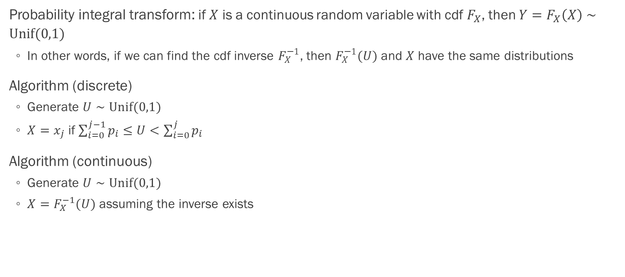
Inverse Transform
Probability integral transform: if $X$ is a continuous random variable with cdf $F_{X}$, then $Y=F_{X}\left(X\right)∼Unif(0,1)$
In other words, if we can find the cdf inverse $F_{X}^{−1}$, then $F_{X}^{−1}(U)$ and $X$ have the same distributions
Algorithm (discrete)
Generate $U∼Unif(0,1)$
$X=x_{j}$ if $\sum_{i=0}^{j−1}{p_{i}}≤U<\sum_{i=0}^{j}{p_{i}}$
Algorithm (continuous)
Generate $U∼Unif(0,1)$
$X=F_{X}^{−1}(U)$ assuming the inverse exists

Slide 16
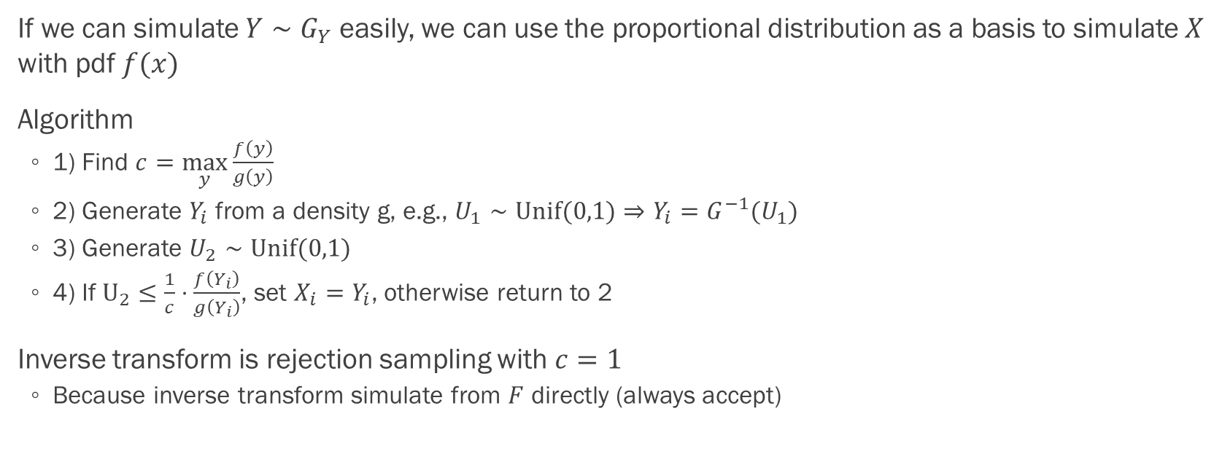
Rejection Sampling
If we can simulate $Y∼G_{Y}$ easily, we can use the proportional distribution as a basis to simulate $X$ with pdf $f(x)$
Algorithm
1) Find $c=\max_{y}{\frac{f\left(y\right)}{g\left(y\right)}}$
2) Generate $Y_{i}$ from a density g, e.g., $U_{1}∼Unif(0,1)⇒Y_{i}=G^{−1}(U_{1})$
3) Generate $U_{2}∼Unif(0,1)$
4) If $U_{2}≤\frac{1}{c}⋅\frac{f\left(Y_{i}\right)}{g\left(Y_{i}\right)}$, set $X_{i}=Y_{i}$, otherwise return to 2
Inverse transform is rejection sampling with $c=1$
Because inverse transform simulate from $F$ directly (always accept)

Slide 17
Variance Reduction Technique

Slide 18
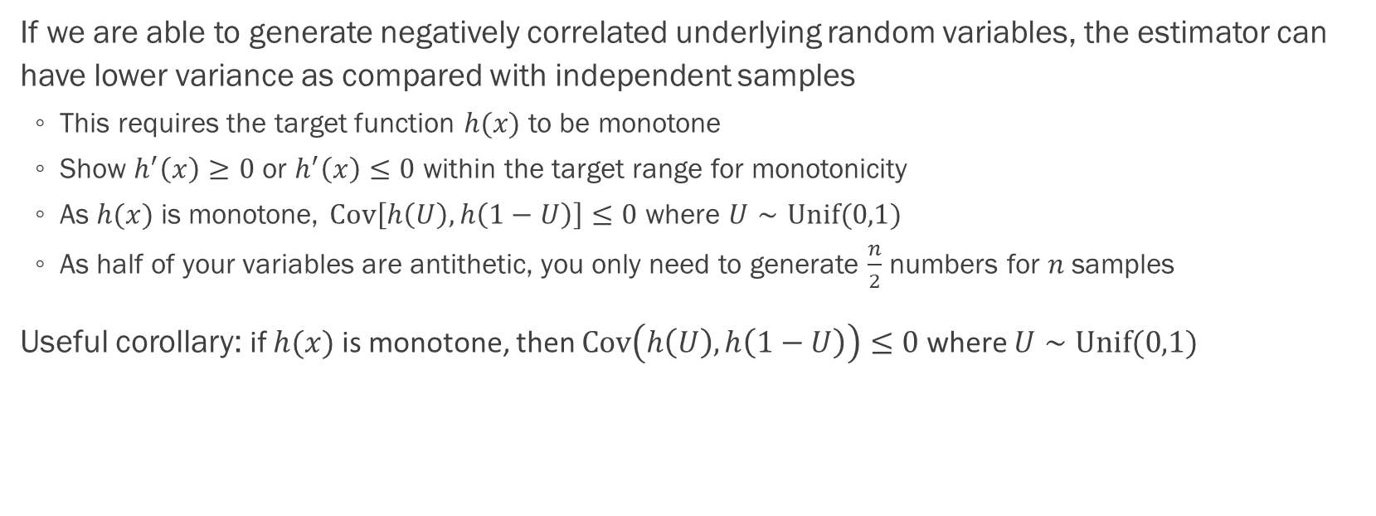
Antithetic Variables
If we are able to generate negatively correlated underlying random variables, the estimator can have lower variance as compared with independent samples
This requires the target function $h(x)$ to be monotone
Show $h^{′}\left(x\right)≥0$ or $h^{′}\left(x\right)≤0$ within the target range for monotonicity
As $h(x)$ is monotone, $Cov\left[h\left(U\right), h\left(1−U\right)\right]≤0$ where $U∼Unif(0,1)$
As half of your variables are antithetic, you only need to generate $\frac{n}{2}$ numbers for $n$ samples
Useful corollary: if $h(x)$ is monotone, then $Cov\left(h\left(U\right), h\left(1−U\right)\right)≤0$ where $U∼\text{Unif}(0,1)$

Slide 19
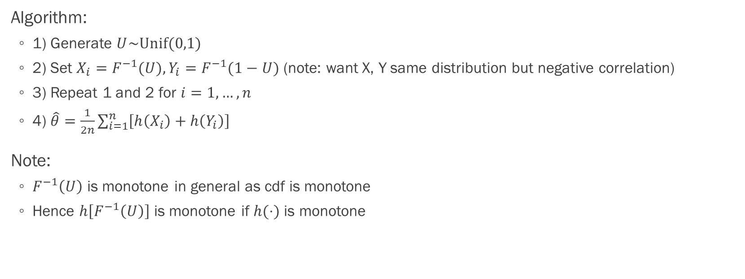
Antithetic Variables
Algorithm:
1) Generate $U\sim Unif(0,1)$
2) Set $X_{i}=F^{−1}(U), Y_{i}=F^{−1}(1−U)$ (note: want X, Y same distribution but negative correlation)
3) Repeat 1 and 2 for $i=1,…,n$
4) $\hat{θ}=\frac{1}{2n}\sum_{i=1}^{n}{\left[h\left(X_{i}\right)+h\left(Y_{i}\right)\right]}$
Note:
$F^{−1}\left(U\right)$ is monotone in general as cdf is monotone
Hence $h\left[F^{−1}\left(U\right)\right]$ is monotone if $h(⋅)$ is monotone

Slide 20
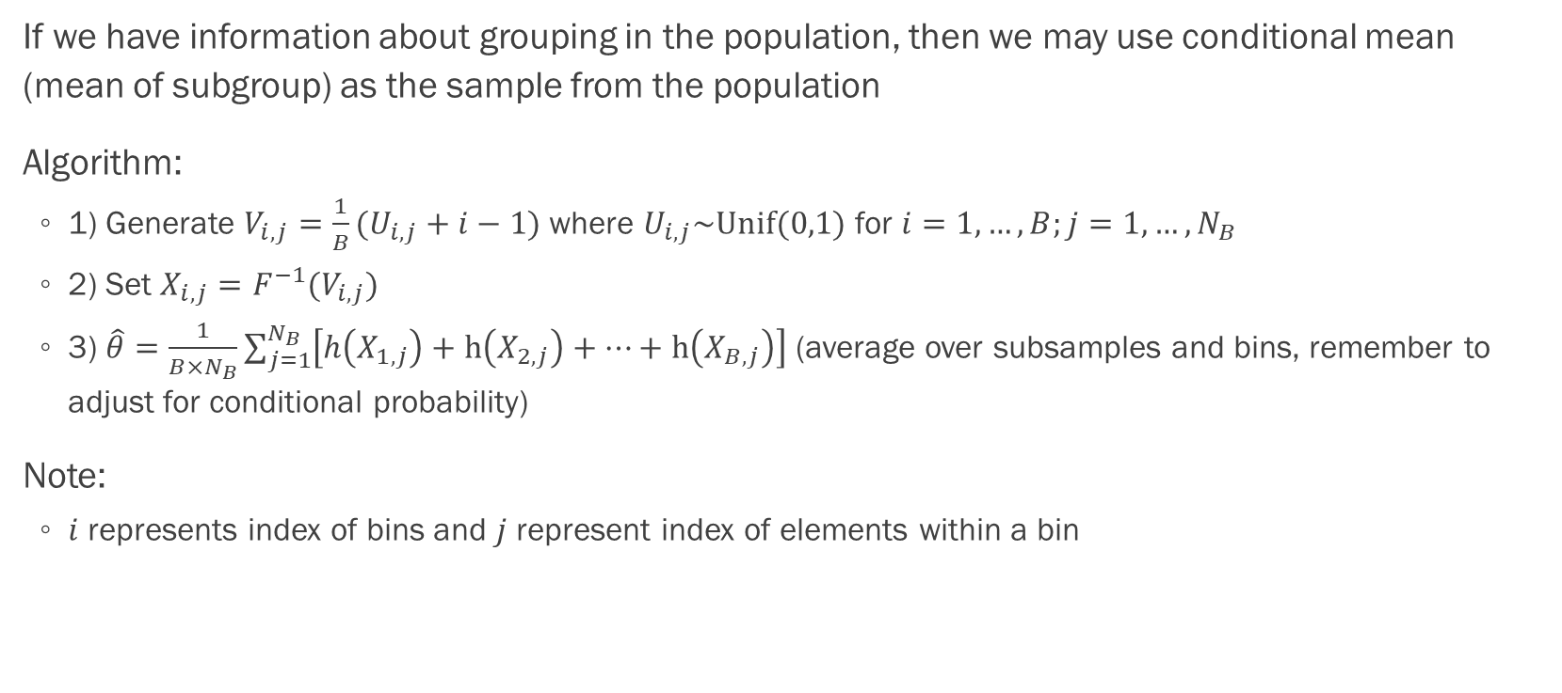
Stratified Sampling
If we have information about grouping in the population, then we may use conditional mean (mean of subgroup) as the sample from the population
Algorithm:
1) Generate $V_{i,j}=\frac{1}{B}(U_{i,j}+i−1)$ where $U_{i,j}\sim Unif(0,1)$ for $i=1,…,B;j=1,…,N_{B}$
2) Set $X_{i,j}=F^{−1}(V_{i,j})$
3) $\hat{θ}=\frac{1}{B×N_{B}}\sum_{j=1}^{N_{B}}{\left[h\left(X_{1,j}\right)+h\left(X_{2,j}\right)+…+h\left(X_{B,j}\right)\right]}$ (average over subsamples and bins, remember to adjust for conditional probability)
Note:
$i$ represents index of bins and $j$ represent index of elements within a bin

Slide 21
Stratified Sampling
When to adjust for conditional probability?
Try to write out the expectation you are trying to approximate (e.g. Ch6 p.43)
Usually you need to when there is an indicator or you have restricted the support

Slide 22
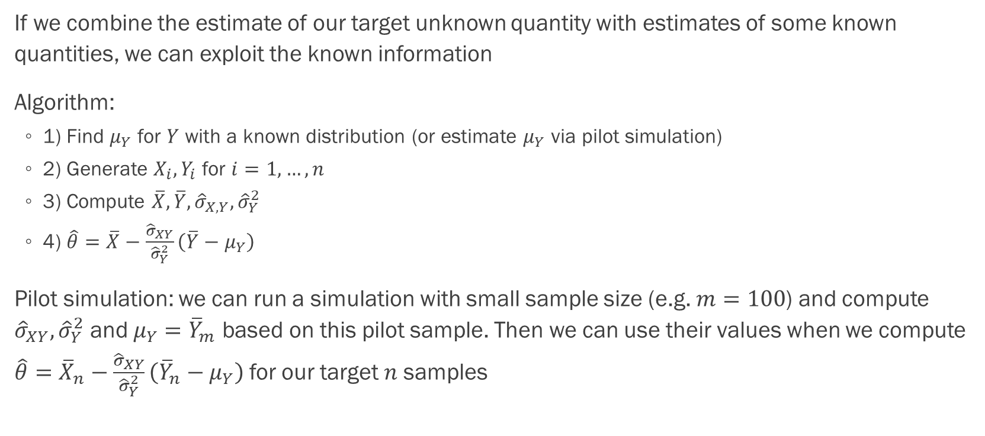
Control Variate
If we combine the estimate of our target unknown quantity with estimates of some known quantities, we can exploit the known information
Algorithm:
1) Find $μ_{Y}$ for $Y$ with a known distribution (or estimate $μ_{Y}$ via pilot simulation)
2) Generate $X_{i}, Y_{i}$ for $i=1,…,n$
3) Compute $\overline{X}, \overline{Y}, {\hat{σ}}_{X,Y}, {\hat{σ}}_{Y}^{2}$
4) $\hat{θ}=\overline{X}−\frac{{\hat{σ}}_{XY}}{{\hat{σ}}_{Y}^{2}}\left(\overline{Y}−μ_{Y}\right)$
Pilot simulation: we can run a simulation with small sample size (e.g. $m=100$) and compute ${\hat{σ}}_{XY}, {\hat{σ}}_{Y}^{2}$ and $μ_{Y}={\overline{Y}}_{m}$ based on this pilot sample. Then we can use their values when we compute $\hat{θ}={\overline{X}}_{n}−\frac{{\hat{σ}}_{XY}}{{\hat{σ}}_{Y}^{2}}\left({\overline{Y}}_{n}−μ_{Y}\right)$ for our target $n$ samples

Slide 23
Control Variate
Properties of effective control: evaluable from simulation data, known mean and high correlation with the simulation variable. Possible candidates are underlying random variable (e.g. uniform when we use inverse transform) and martingale transform (will not be tested)
Note:
The algorithm in last slide is one-off, i.e. it does not affect each sample
So we should use control variate last if we were to combine the methods

Slide 24
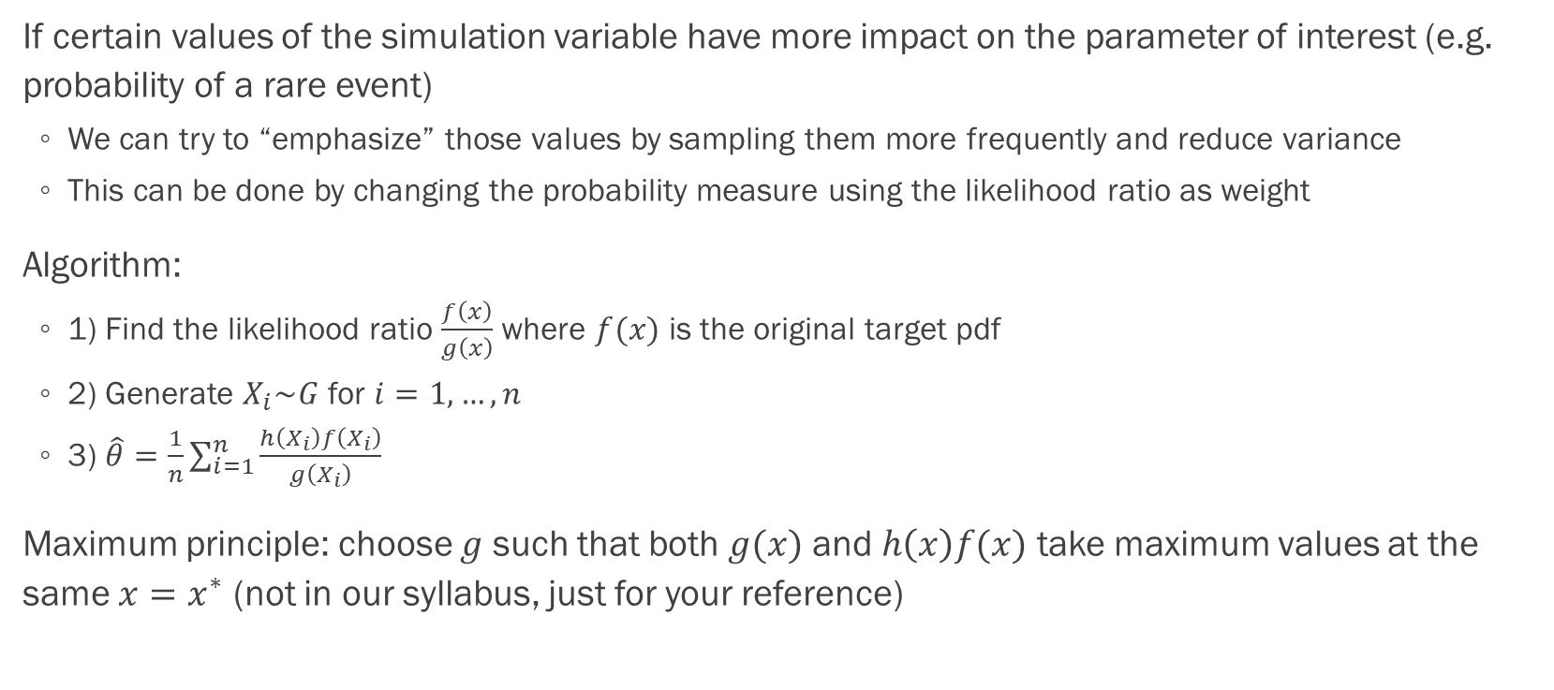
Importance Sampling
If certain values of the simulation variable have more impact on the parameter of interest (e.g. probability of a rare event)
We can try to “emphasize” those values by sampling them more frequently and reduce variance
This can be done by changing the probability measure using the likelihood ratio as weight
Algorithm:
1) Find the likelihood ratio $\frac{f\left(x\right)}{g\left(x\right)}$ where $f(x)$ is the original target pdf
2) Generate $X_{i}\sim G$ for $i=1,…,n$
3) $\hat{θ}=\frac{1}{n}\sum_{i=1}^{n}{\frac{h\left(X_{i}\right)f\left(X_{i}\right)}{g\left(X_{i}\right)}}$
Maximum principle: choose $g$ such that both $g(x)$ and $h\left(x\right)f(x)$ take maximum values at the same $x=x^{∗}$ (not in our syllabus, just for your reference)

Slide 25
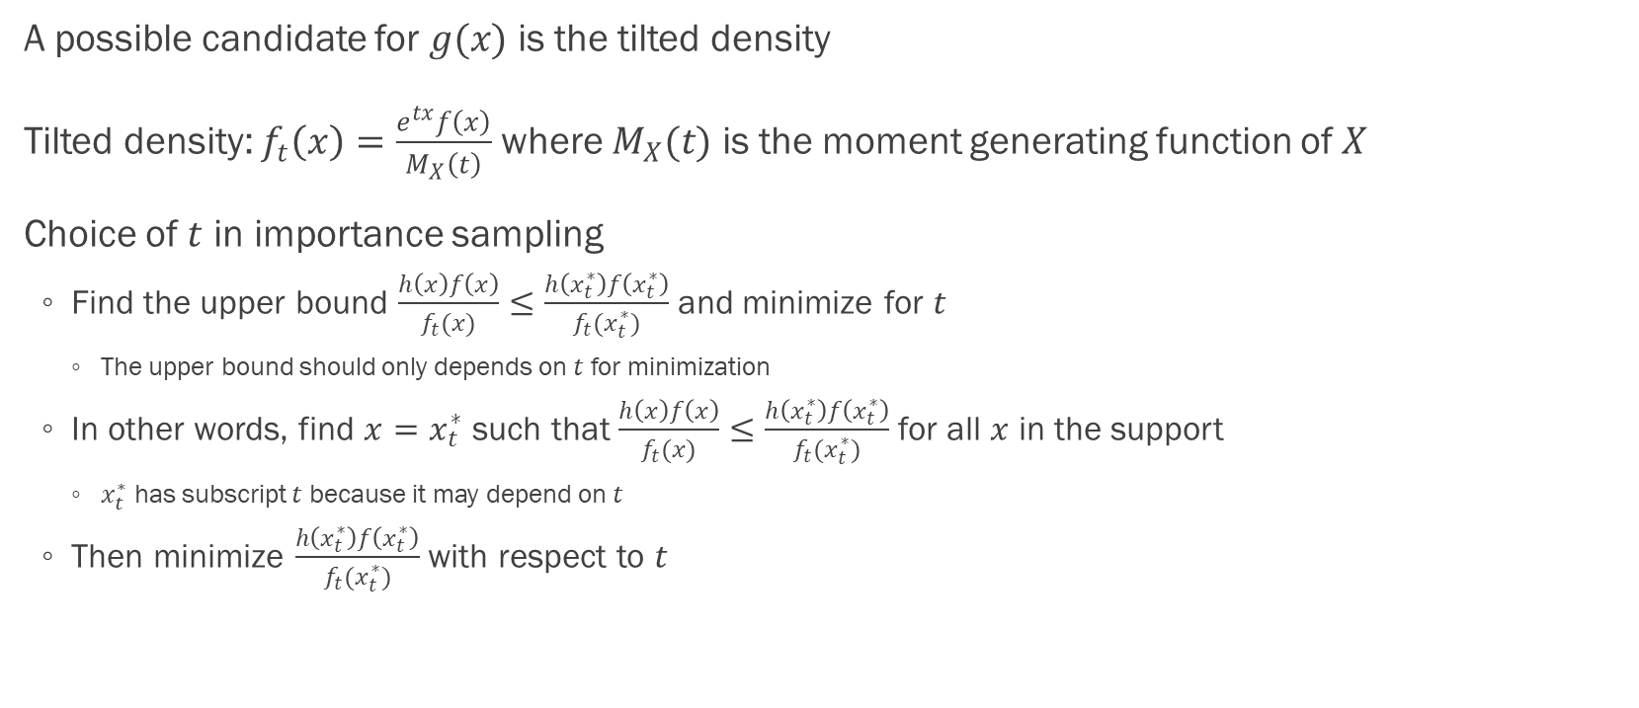
Importance Sampling
A possible candidate for $g(x)$ is the tilted density
Tilted density: $f_{t}\left(x\right)=\frac{e^{tx}f\left(x\right)}{M_{X}\left(t\right)}$ where $M_{X}(t)$ is the moment generating function of $X$
Choice of $t$ in importance sampling
Find the upper bound $\frac{h\left(x\right)f\left(x\right)}{f_{t}(x)}≤\frac{h\left(x_{t}^{∗}\right)f\left(x_{t}^{∗}\right)}{f_{t}(x_{t}^{∗})}$ and minimize for $t$
The upper bound should only depends on $t$ for minimization
In other words, find $x=x_{t}^{∗}$ such that $\frac{h\left(x\right)f\left(x\right)}{f_{t}(x)}≤\frac{h\left(x_{t}^{∗}\right)f\left(x_{t}^{∗}\right)}{f_{t}(x_{t}^{∗})}$ for all $x$ in the support
$x_{t}^{∗}$ has subscript $t$ because it may depend on $t$
Then minimize $\frac{h\left(x_{t}^{∗}\right)f\left(x_{t}^{∗}\right)}{f_{t}(x_{t}^{∗})}$ with respect to $t$

Slide 26
Simulation in Action

Slide 27
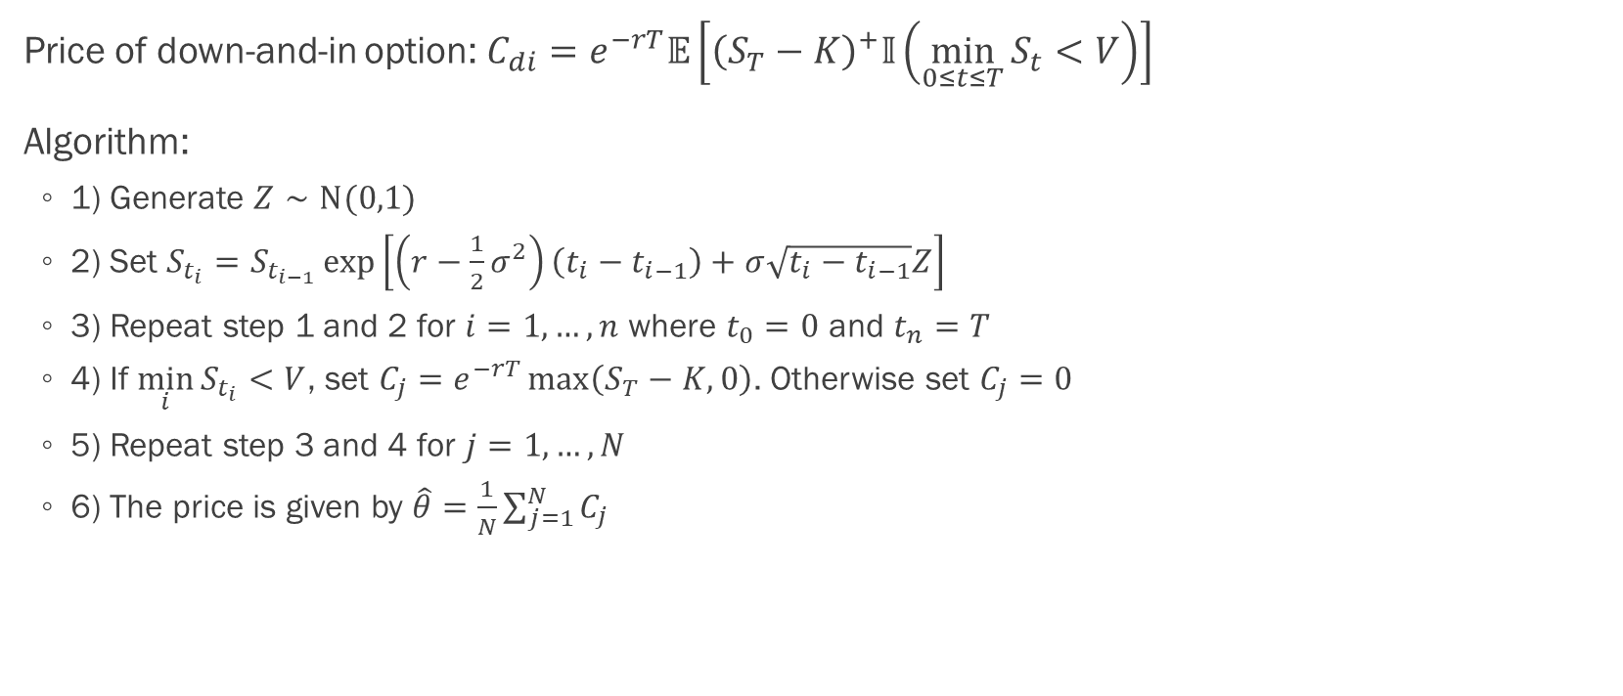
Down-and-in Call Option
Price of down-and-in option: $C_{di}=e^{−rT}𝔼\left[{\left(S_{T}−K\right)}^{+}𝕀\left(\min_{0≤t≤T}{S_{t}}<V\right)\right]$
Algorithm:
1) Generate $Z∼N(0,1)$
2) Set $S_{t_{i}}=S_{t_{i−1}}\exp\left[\left(r−\frac{1}{2}σ^{2}\right)\left(t_{i}−t_{i−1}\right)+σ\sqrt{t_{i}−t_{i−1}}Z\right]$
3) Repeat step 1 and 2 for $i=1,…,n$ where $t_{0}=0$ and $t_{n}=T$
4) If $\min_{i}{S_{t_{i}}}<V$, set $C_{j}=e^{−rT}\max\left(S_{T}−K,0\right)$. Otherwise set $C_{j}=0$
5) Repeat step 3 and 4 for $j=1,…,N$
6) The price is given by $\hat{θ}=\frac{1}{N}\sum_{j=1}^{N}{C_{j}}$

Slide 28
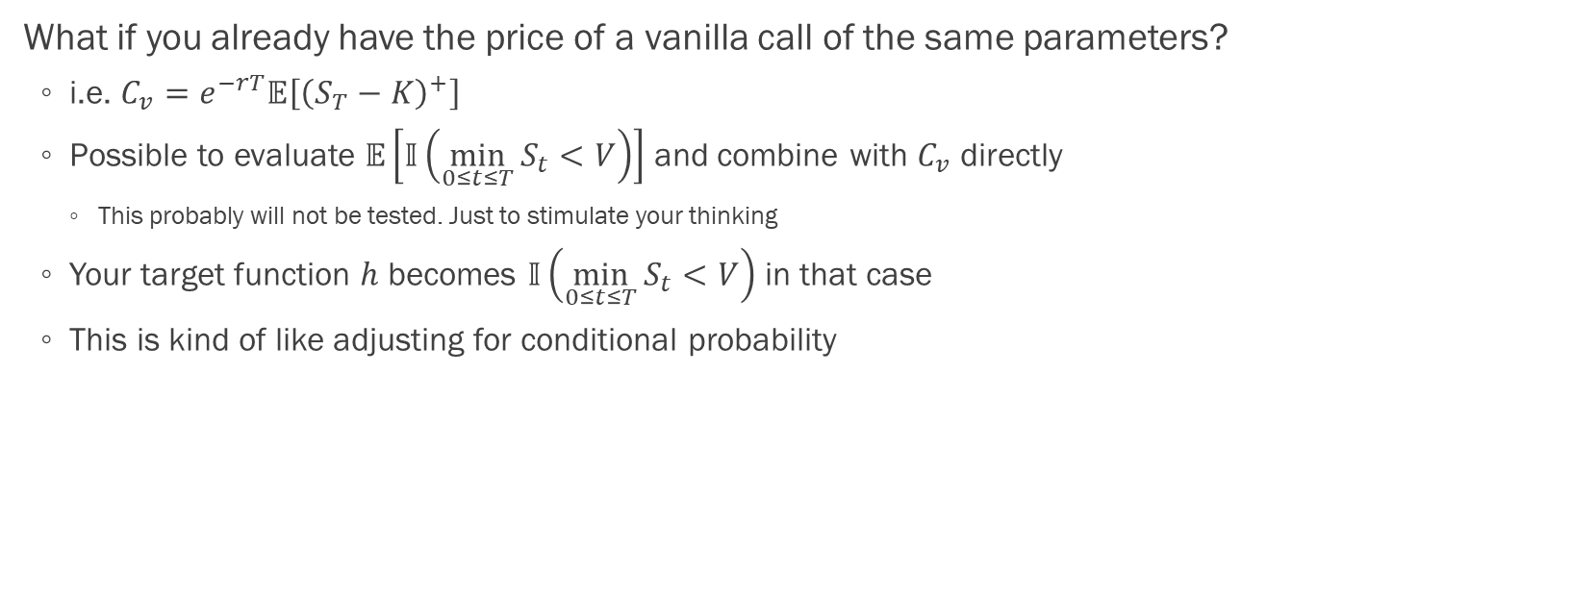
Down-and-in Call Option
What if you already have the price of a vanilla call of the same parameters?
i.e. $C_{v}=e^{−rT}𝔼\left[{\left(S_{T}−K\right)}^{+}\right]$
Possible to evaluate $𝔼\left[𝕀\left(\min_{0≤t≤T}{S_{t}}<V\right)\right]$ and combine with $C_{v}$ directly
This probably will not be tested. Just to stimulate your thinking
Your target function $h$ becomes $𝕀\left(\min_{0≤t≤T}{S_{t}}<V\right)$ in that case
This is kind of like adjusting for conditional probability

Slide 29
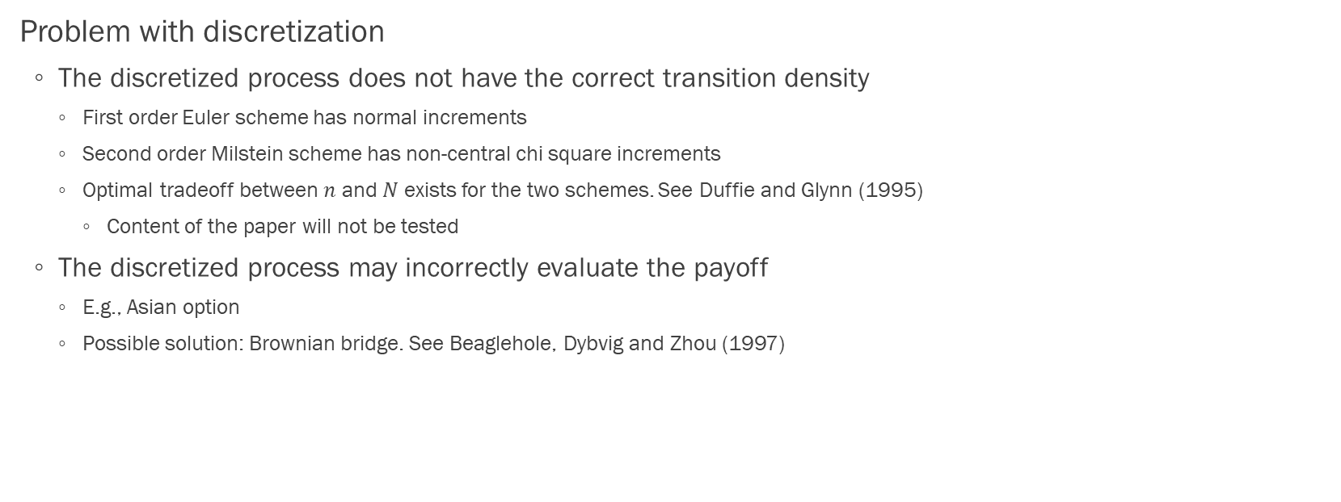
Path-dependent Option
Problem with discretization
The discretized process does not have the correct transition density
First order Euler scheme has normal increments
Second order Milstein scheme has non-central chi square increments
Optimal tradeoff between $n$ and $N$ exists for the two schemes. See Duffie and Glynn (1995)
Content of the paper will not be tested
The discretized process may incorrectly evaluate the payoff
E.g., Asian option
Possible solution: Brownian bridge. See Beaglehole, Dybvig and Zhou (1997)

Slide 30
Path-dependent Option
American option
Problem with branching paths
Possible solution: linear regression. See Longstaff and Schwartz (2001)
Just for your interest
Consider taking courses from Prof. Wong :P He taught us this in undergrad

Slide 31

Q&A
Thank you for taking RMSC5102! Write me (or department) an email if you like my tutorials :P
Let’s keep in touch :)

